Slide 1

Home Rental Analysis
Presented by:-
ISHAD SATYEN
RAKESH KR TATWA
PRINCE KUMAR
Guide by ,
Dr . Nidhi Chahal

Slide 2

Contents
Introduction
Exploratory Data Analysis
Classification
Time Series

Slide 3
Introduction of Airbnb
An American company that operates an online marketplace for lodging, primarily homestays for vacation rentals, and tourism activities.
Airbnb was started in 2008 by Brian Cheeky and Joe Gibbie, two industrial designers who had recently moved to San Francisco.
Its popularity stems from the fact that not everyone who is travelling can afford to stay in a hotel, much less find a hotel room at all in a busy urban area.

Slide 4
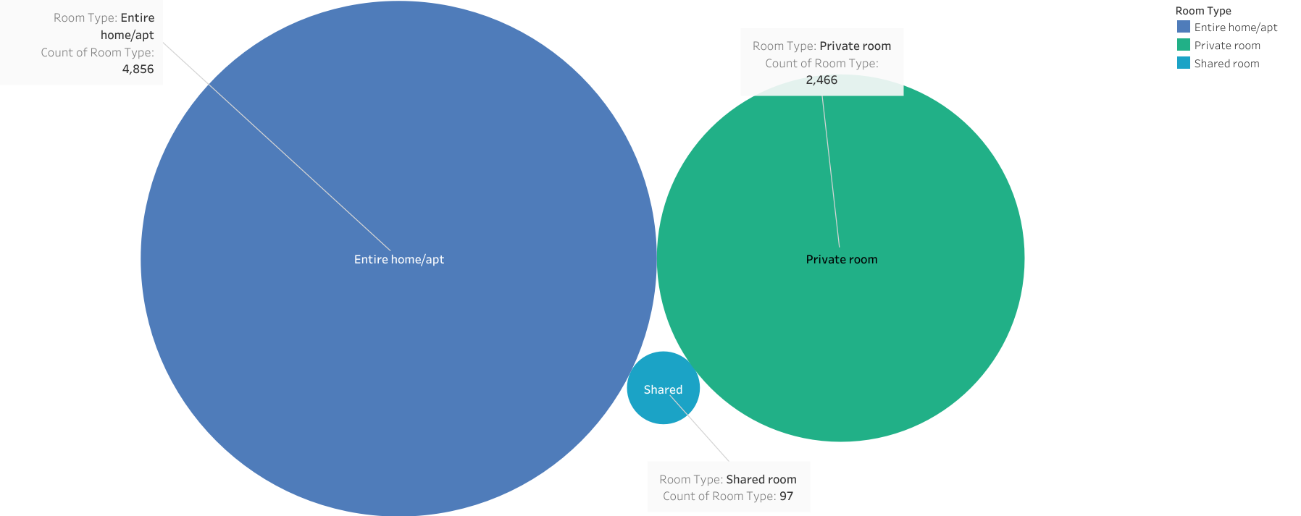

Slide 5
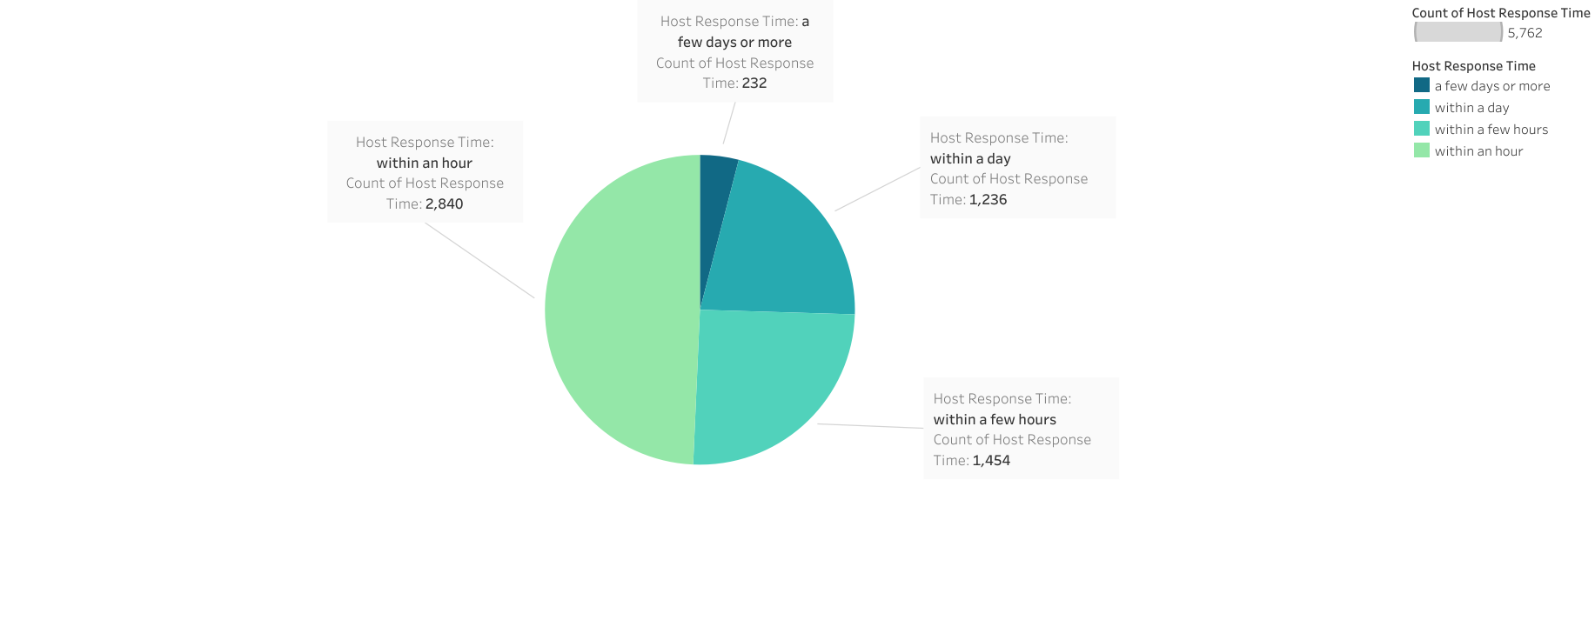

Slide 6
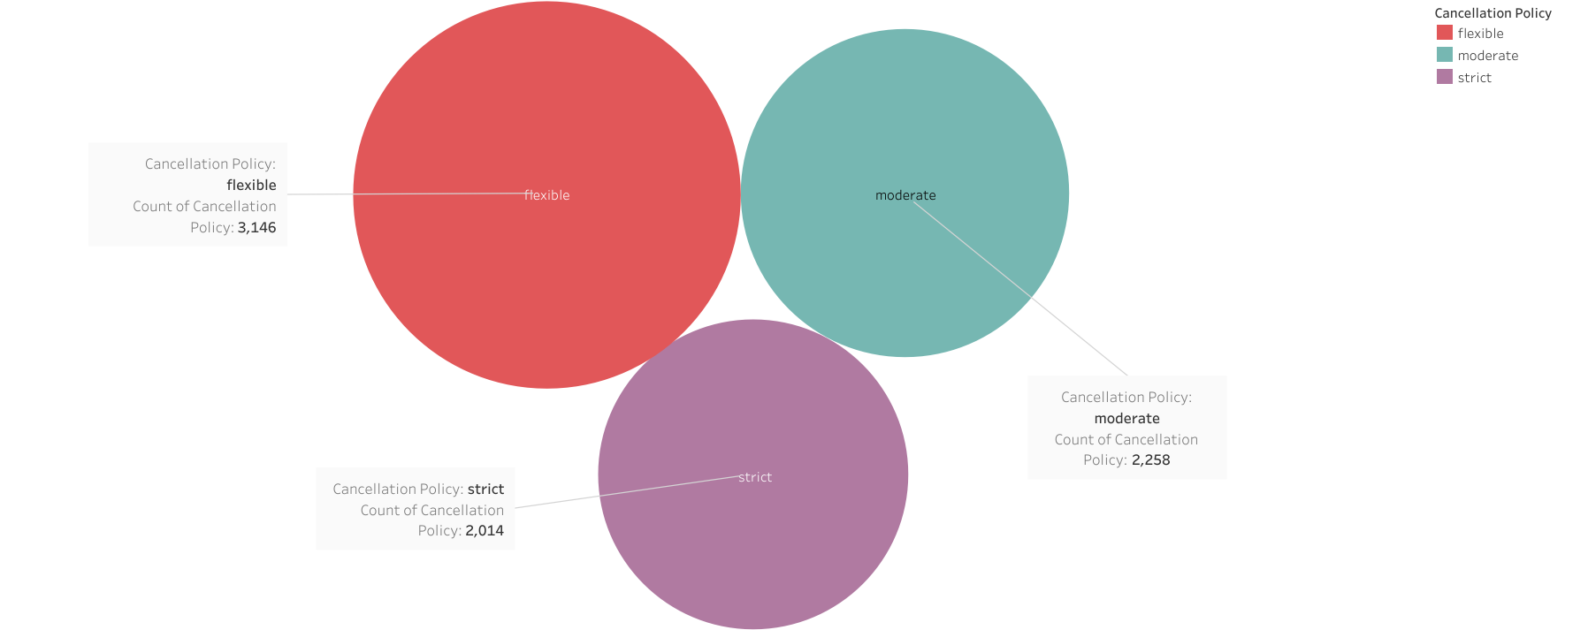

Slide 7
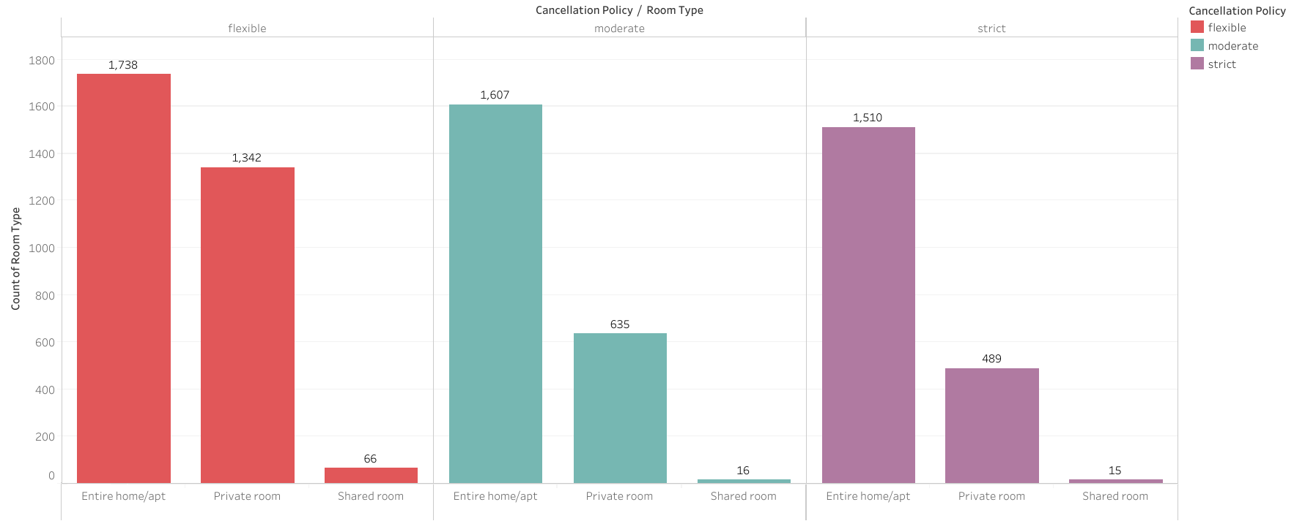

Slide 8
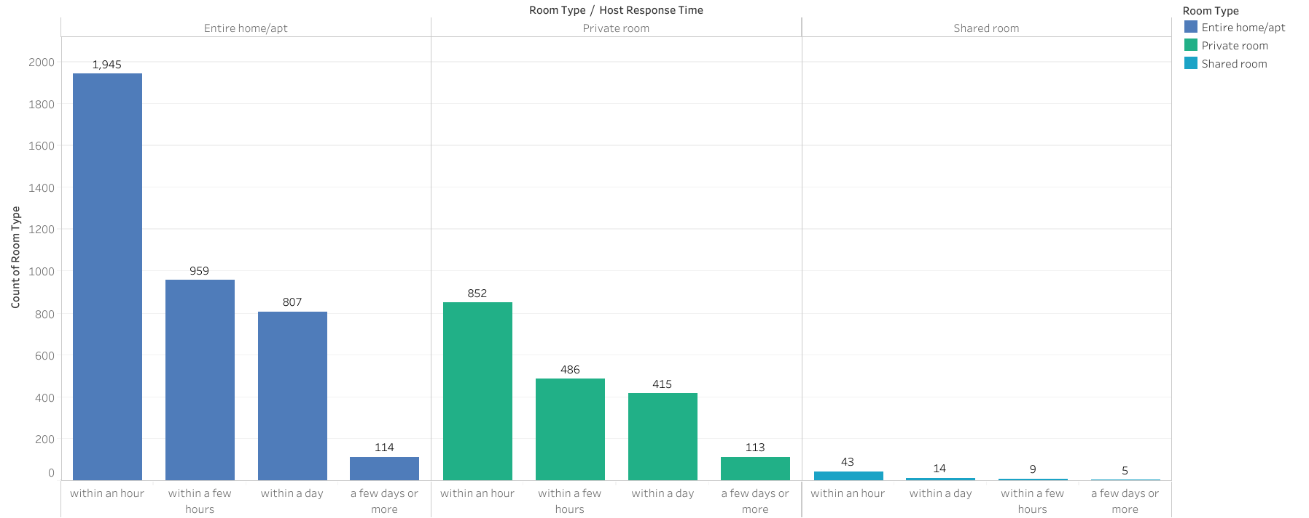

Slide 9
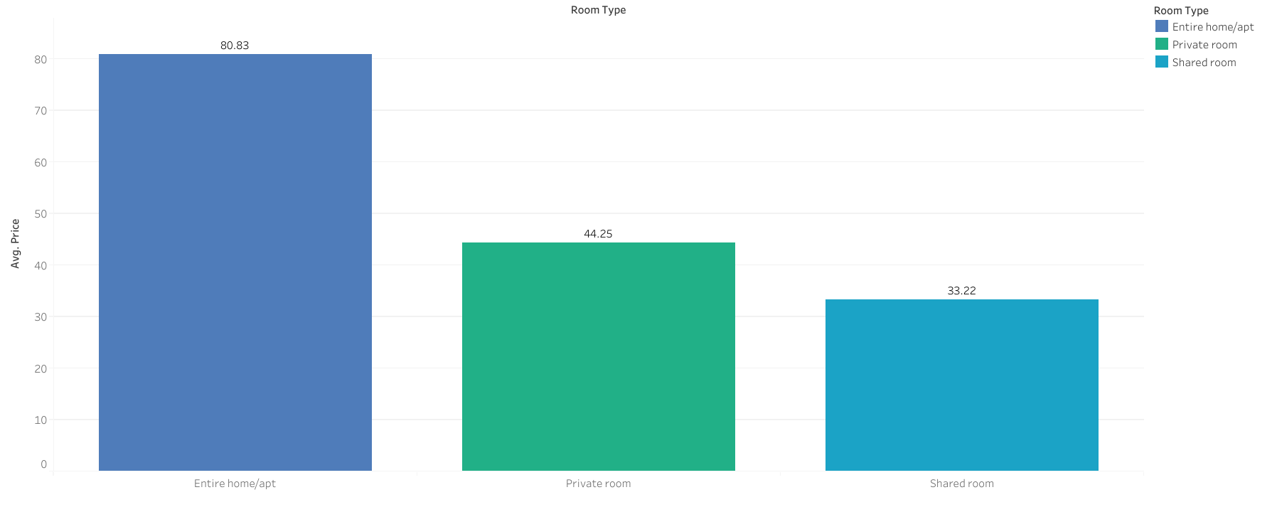

Slide 10
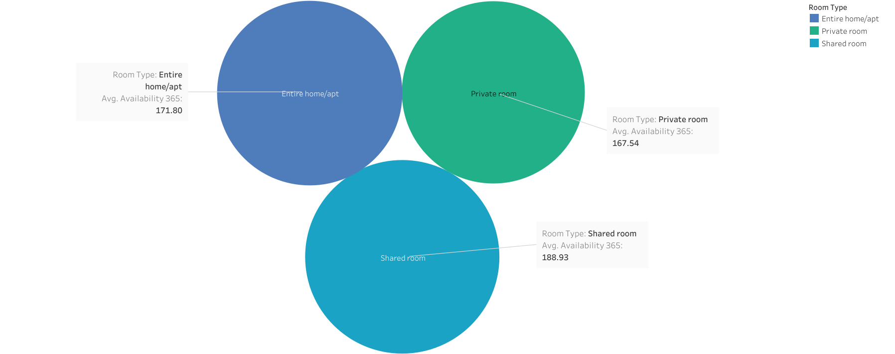

Slide 11
Property Type Prediction
Problem Statement 3: Build a classification model that will predict ‘Property Type’ a customer likely to select , given a set of input features.
property Type | Count of Property Type
Apartment | 5698
Bed & Breakfast | 178
Boat | 2
Boutique hotel | 3
Cabin | 7
Camper/RV | 1
Castle | 3
Chalet | 1
Condominium | 87
Dorm | 5
Earth House | 2
Guest suite | 2
Guesthouse | 41
Hostel | 2
House | 997
Loft | 190
Other | 35
Serviced apartment | 5
Tent | 1
Timeshare | 1
Townhouse | 134
Villa | 23
Yurt | 1
(blank)
Grand Total | 7419
We have taken a all category of a property type to prediction.

Slide 12
Features which we are selected for Prediction of a Property Type from the given Belgium Dataset.
Price
Room Type
Features
Bed Room
Host Total Listing Count
Property Type
Label
The models which we are applied for classification to predict the Property Types.
MODELS
K-Nearest Neighbour
Naïve-Bayes
Logistic Regression
Random Forest

Slide 13
Model Evaluation
Model Classifier | Accuracy | Precision | Recall | f1-score
K-Nearest Neighbor | 0.7651 | 0.77 | 0.77 | 0.77
Naïve-Bayes | 0.5245 | 0.52 | 0.52 | 0.52
Logistic Regression | 0.76095 | 0.76 | 0.76 | 0.76
Random Forest | 0.74022 | 0.74 | 0.74 | 0.74
Among all the classifier K-NN giving a better accuracy compared to others.

Slide 14
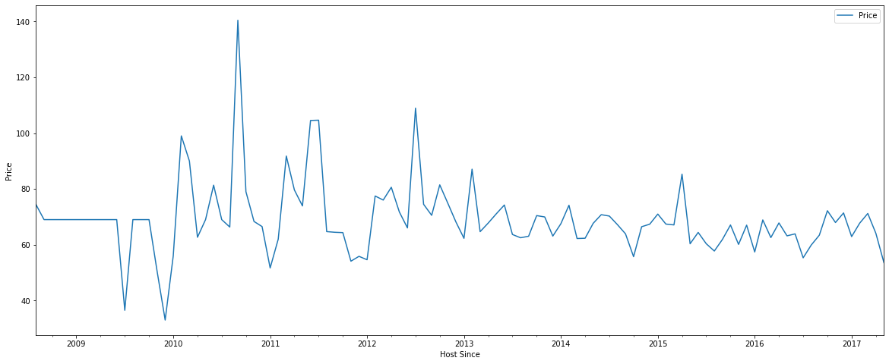
Property Price Forecasting
Problem Statement : Time series model forecasting the property price based on given data.
Features Selected: Host Since and Price

Slide 15
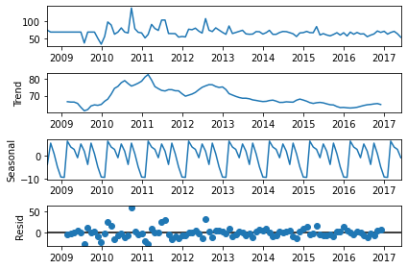
Checking for seasonality and Trend
It shows the downward trend as well as seasonality.

Slide 16
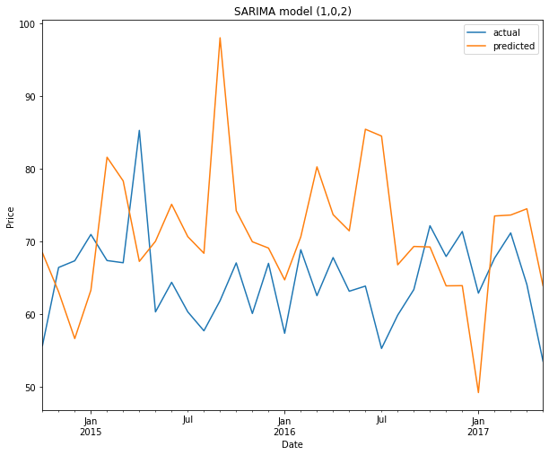
SARIMA MODEL

Slide 17
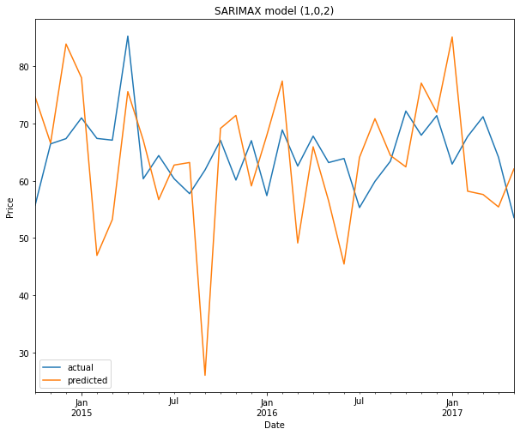
SARIMAX MODEL

Slide 18
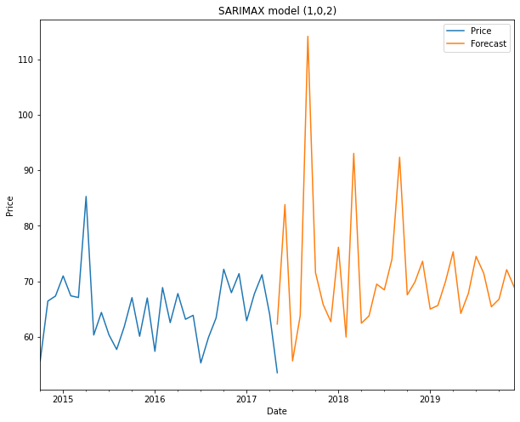
SARIMAX FORCASTING MODEL

Slide 19


